Slide 1

JS
FS dev 101
Call , bind & Apply in JavaScript

Slide 2
this
const test = {
prop: 42,
func: function() {
return this.prop;
},
};
console.log(test.func());
// expected output: 42

Slide 3
Execution context
Global
Function —> strict or non strict
Object

Slide 4
Global Context
// In web browsers, the window object is also the global object:
console.log(this === window); // true
a = 3;
console.log(window.a); // 3
this.b = "GUVI";
console.log(window.b) // "GUVI"
console.log(b) // “GUVI"

Slide 5
Default - Non-Strict
function f1() {
return this;
}
// In a browser:
f1() === window; // true
// In Node:
f1() === global; // true

Slide 6
Strict Mode
function f2() {
'use strict'; // see strict mode
return this;
}
f2() === undefined; // true

Slide 7



this
printFullName
printName: function() {
console.log(this.firstName + ' ' + this.lastName);
}
};
const person = {
firstName: 'John',
lastName: 'Doe',
printName: function() {
console.log(this.firstName + ' ' + this.lastName);
}
};
var printFullName = person.printName;
printFullName();
undefined undefined
person.printName();
John Doe
this —> A property of an execution context

Slide 8
Call , Apply Bind
call() and apply() were introduced in ECMAScript 3
bind() was added as part of ECMAScript 5

Slide 9


Call and Apply

Slide 10

Bind

Slide 11
Call Apply
// An object can be passed as the first argument to call or apply and this will be bound to it.
var obj = {a: 'Custom'};
// This property is set on the global object
var a = 'Global';
function whatsThis() {
return this.a; // The value of this is dependent on how the function is called
}
whatsThis(); // 'Global'
whatsThis.call(obj); // 'Custom'
whatsThis.apply(obj); // 'Custom'

Slide 12
Syntax
call(thisArg, arg1, arg2, ...)
apply(thisArg, argsArray)
bind(thisArg[, arg1[, arg2[, ...]]])
https://stackoverflow.com/questions/15455009/javascript-call-apply-vs-bind

Slide 13
const john = {
name: 'John',
age: 24,
};
function greeting() {
console.log(`Hi, I am ${this.name} and I am ${this.age} years old`);
}
const greetingJohn = greeting.bind(john);
greetingJohn();

Slide 14
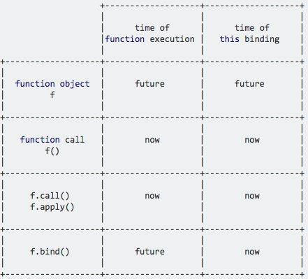

Slide 15
Recap
Call invokes the function and allows you to pass in arguments one by one.
Apply invokes the function and allows you to pass in arguments as an array.
Call and apply are pretty interchangeable
Bind returns a new function, allowing you to pass in a this array and any number of arguments.
Function Currying

Slide 16
Tasks
var func = function() {
console.log(this)
}.bind(1);
func();

Slide 17
Tasks
var func = function() {
console.log(this)
}.bind(1);
var obj = {
callFun : func
}
obj.callFun.func();

Slide 18
Tasks
function checkFun(a, b, c){
console.log(this);
console.log(a);
console.log(b);
console.log(c);
}
checkFun.call(1,2,3,4);

Slide 19
Tasks
function checkFun(a, b, c){
console.log(this);
console.log(a);
console.log(b);
console.log(c);
}
checkFun.apply(1,[2,3,4]);

Slide 20
Tasks
function sumOfNumbers() {
var total = 0;
for(var i = 0; i < arguments.length; i++){
total += arguments[i];
}
return total;
}
var sum = sumOfNumbers(1,2,3);
console.log(sum);

Slide 21
Tasks
function sumOfNumbers() {
var total = 0;
for(var i = 0; i < arguments.length; i++){
total += arguments[i];
}
return total;
}
var sum = sumOfNumbers.call(null,1,2,3);
console.log(sum);

Slide 22
Tasks
var total = 0;
for(var i = 0; i < arguments.length; i++){
total += arguments[i];
}
return total;
}
var numbers = [1,2,3];
var sum = sumOfNumbers.apply(null, numbers);
console.log(sum);

Slide 23
Tasks
function updateZipCode() {
console.log(this)
}
updateZipCode.call(1);

Slide 24
Tasks
var updateZipCode = function () {
console.log(this);
};
updateZipCode.call({ zip: '11787'});

Slide 25
Tasks
var updateZipCode = function (newZip, country) {
console.log(newZip + ' ' + country);
};
var zipCode = {
zip: '11787'
};
updateZipCode.call(zipCode, '11888', 'us');

Slide 26
Tasks
"use strict";
var zipcode = {
checkZipcode : function() {
console.log(this);
function updateZipCode() {
console.log(this);
}
updateZipCode.call(this);
}
}
zipcode.checkZipcode();

Slide 27
Tasks
"use strict";
var zipcode = {
checkZipcode : function() {
console.log(this);
var updateZipCode = function() {
console.log(this);
}.bind(this);
updateZipCode();
}
}
zipcode.checkZipcode();

Slide 28
Tasks
"use strict";
var person = {
name : "Jack",
prop : {
name : "Daniel",
getName : function() {
return this.name;
}
}
}
var name = person.prop.getName.bind(person);
console.log(name());
var name = person.prop.getName();
console.log(name);

Slide 29
Thanks

